Slide 1

EVALUATION OF MODEL
TASK 2: Predicting customer buying behaviour

Slide 2
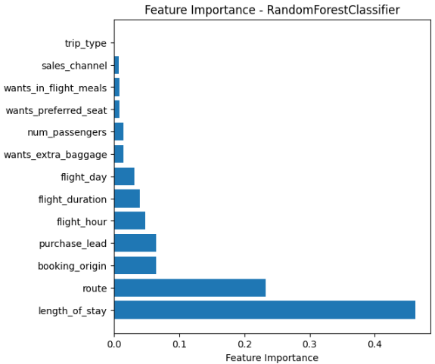
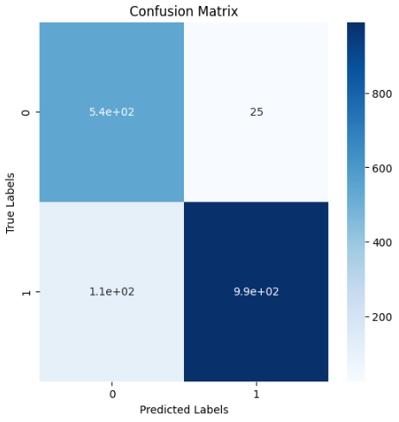
Model Accuracy : 92%
Key Metrics:
Class 0 -:
Precision: 83%
Recall: 96%
F1-Score: 89%
Class 1 -:
Precision: 98%
Recall: 90%
F1-Score: 94%
Hence, Length of stay feature is most important

